Slide 1
Office 365 development
Speaker name

Slide 2
Deep dive into Office 365 Connectors

Slide 3
Agenda
Introduction
Office 365 Connectors Overview
Developing Connectors
Advanced Scenarios

Slide 4

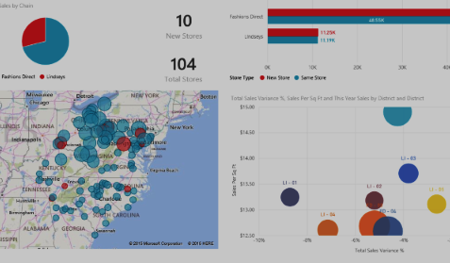

Office 365 Developer opportunity
Users
Data
Intelligence
1.2B Office users
85% of Fortune 500 companies have Office 365
4T+ emails sent with O365
Microsoft Graph API calls
420% monthly growth
50K+ new O365 small businesses per month
340M downloads of Office mobile
3B minutes of Skype calls daily
1B+ meetings created per month
Notes:
The developer opportunity with Office 365 is significant
There are 1.2B users of Office world-wide…imagine adding your own brand/mark on an application that 1.2B users use!
Office 365 is growing at astronomical rates with 50K new small business monthly subscriptions and 85% of Fortune 500
The volume of collaboration that occurs in Microsoft’s cloud productivity tools is equally substantial with 4T+ emails, 3B minutes of daily Skype calls, and 1B+ meetings monthly
Much of this data and the insights behind it are available through the Microsoft Graph

Slide 5
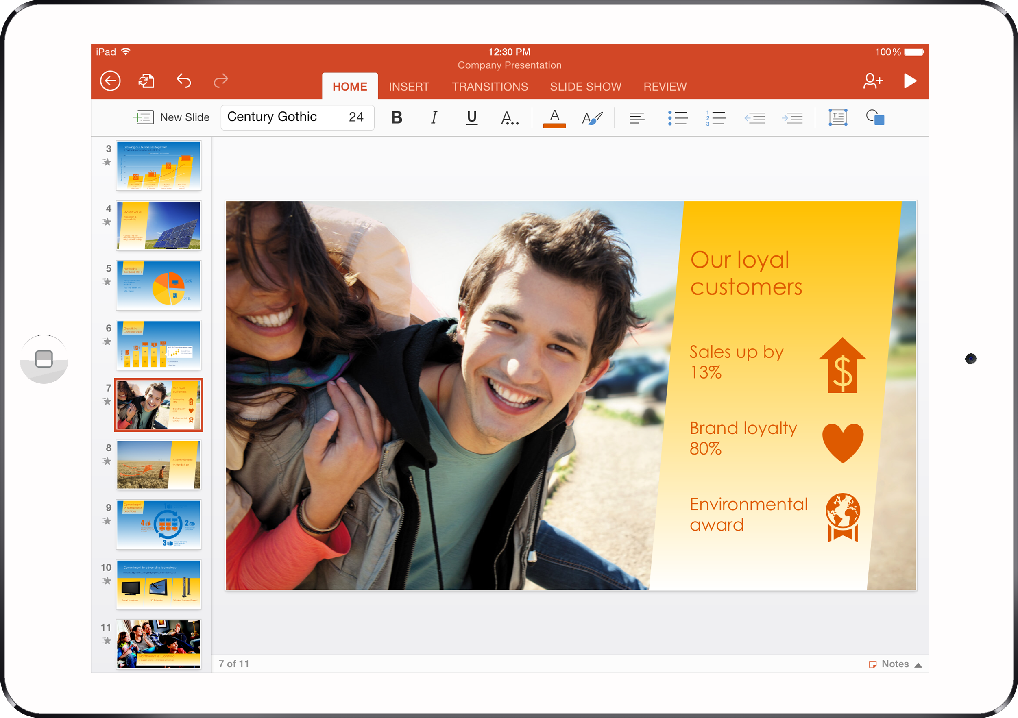

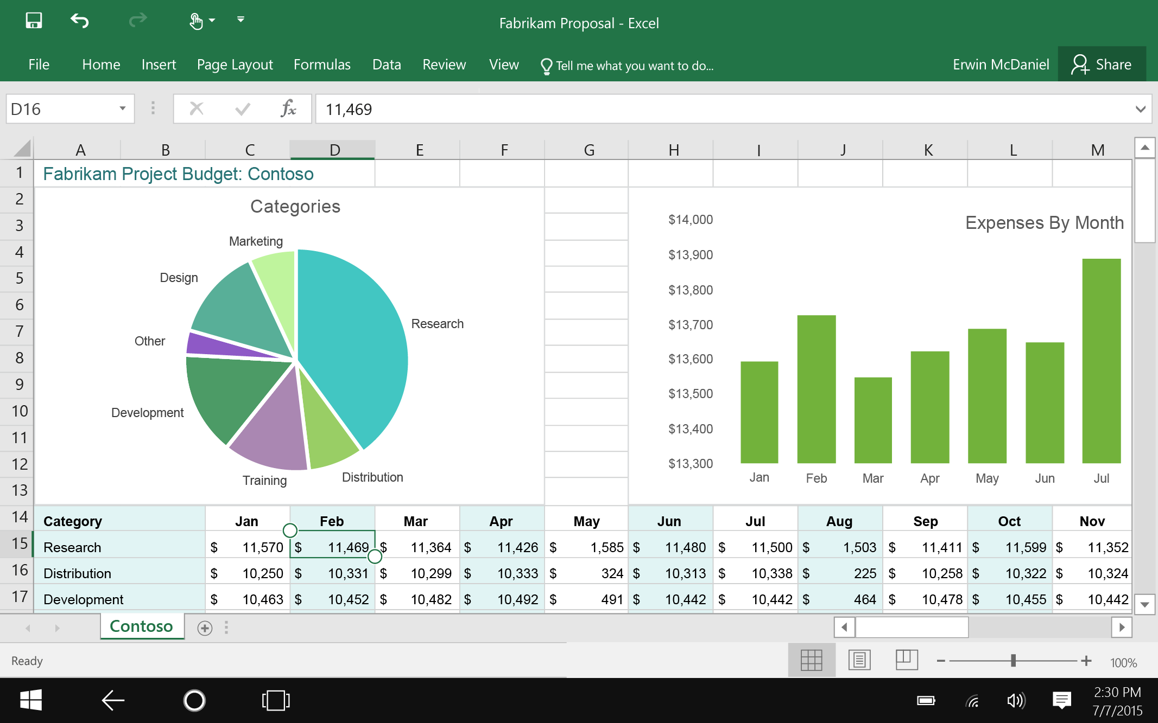
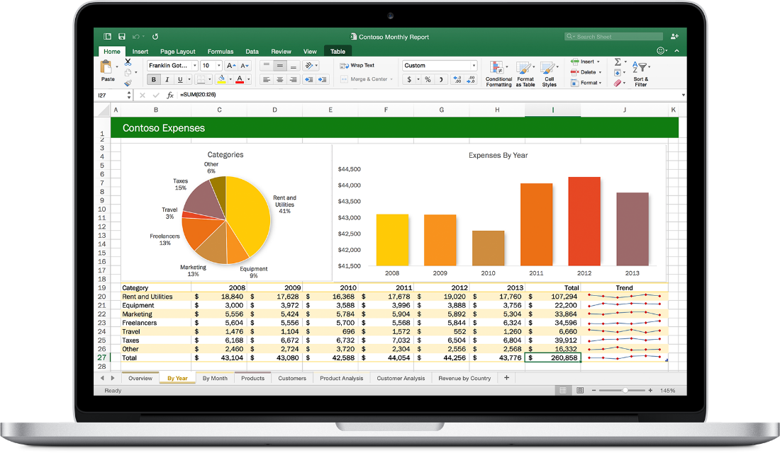
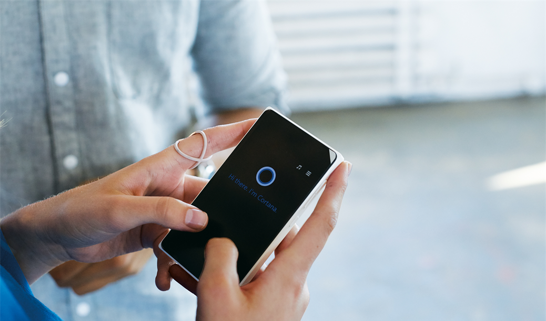
Office 365 Developer opportunity
Build intelligent apps by connecting to Office services
Platform opportunities available today
Make your solution part of
Office apps
Engage users through conversations
Notes:
So the opportunity is obviously significant…so how do we empower developers?
First, we allow you easily tap into the rich productivity data and insights in the cloud via the Microsoft Graph...ultimately...adding Office to your app
Second, we want you to be able to extend Office and reach the 1.2B Office users through add-ins...ultimately...adding your app into Office
Finally, we want developers to be able to engaged users through near-realtime conversations in platforms like Skype for Business and Office 365 Groups
Let’s take a look at the first of these...the Microsoft Graph...in more detail

Slide 6
1
Office 365 Connectors Overview

Slide 7
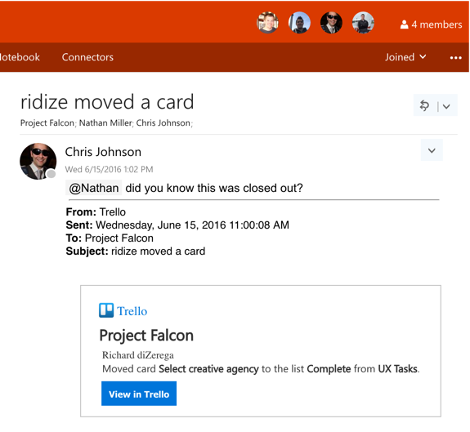
What is an Office 365 Connector
Enables useful third party information to be sent into Office 365 Groups
Allows users to have conversations, collaborate, and take action on third party data
Information sent into Connectors can be transactional or aggregated
Connectors can be added to Groups from the Connector Catalog in Office 365 or from third party applications
Office 365 provides a Connectors catalog for efficient developer publication and user discovery

Slide 8





Types of Connectors
First Party Connectors
Built or curated by Microsoft, typically in response to popularity, scenario, or reach
Available through the Connectors catalog
Custom configuration page allows specialized subscription to the connector
Third Party Connectors
Built by any developer or third party with useful information to send into Office 365
Available through the Connectors catalog or through the third parties application(s)
Custom subscriptions managed by the third party from their application

Slide 9











Early Adopters

Slide 10
Office 365 Connectors
Demo
Notes:
Demonstrate the Twitter or Trello connector and show conversations with the cards that are sent

Slide 11
2
Developing Office 365 Connectors

Slide 12
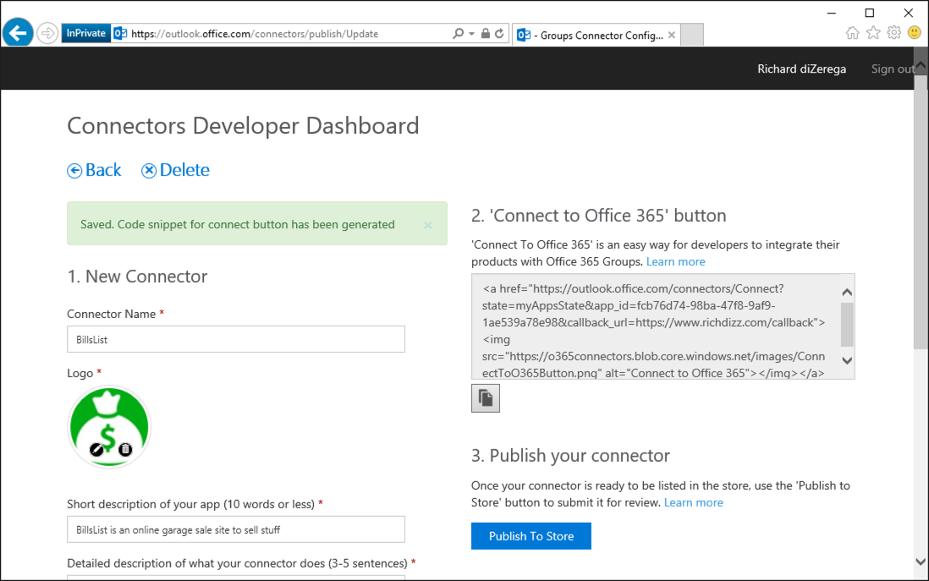
Registration
https://outlook.office.com/connectors/publish
Provide details such as Name, Logo, Description, Redirect URL (subscription callback), etc

Slide 13
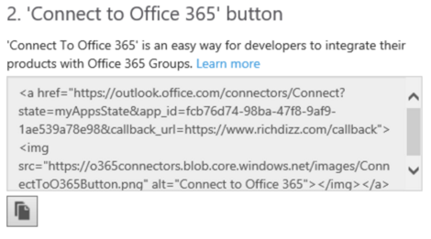
“Connect to Office 365” Markup
”Connect to Office 365” markup is generated when the registration is saved
Markup can be placed on any website for easy Connector integration
The href of the markup contains all the parameters to perform a successful Connector subscription flow
The state parameter can be used to keep track of where the users was or preferences they have selected

Slide 14
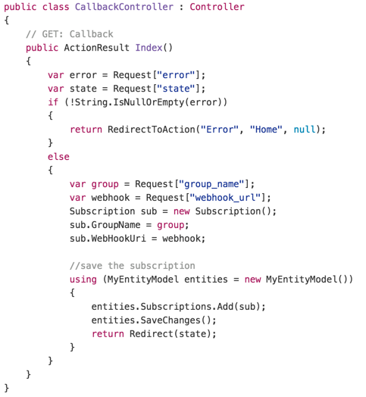
Subscription Callback
3rd party page/view that Office 365 uses to respond with details of a successful connector consent
Office 365 sends details such as the group_name and a webhook_url for sending data into Office 365
The callback URI is not dynamic and must match the value specified in the connector registration (use state parameter for dynamic scenarios)
Keep webhook endpoint secure as it is app-specific and can be called without a Bearer token

Slide 15
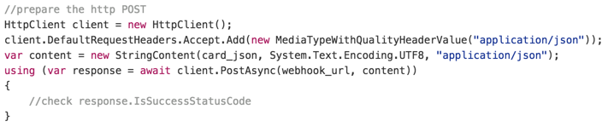
Calling Webhooks
Perform HTTP POST to the webhook endpoint with Connector Card JSON in body
Uses standard HTTP POST with application/json content type
Connector Card schema documented at https://dev.outlook.com/Connectors/Reference

Slide 16
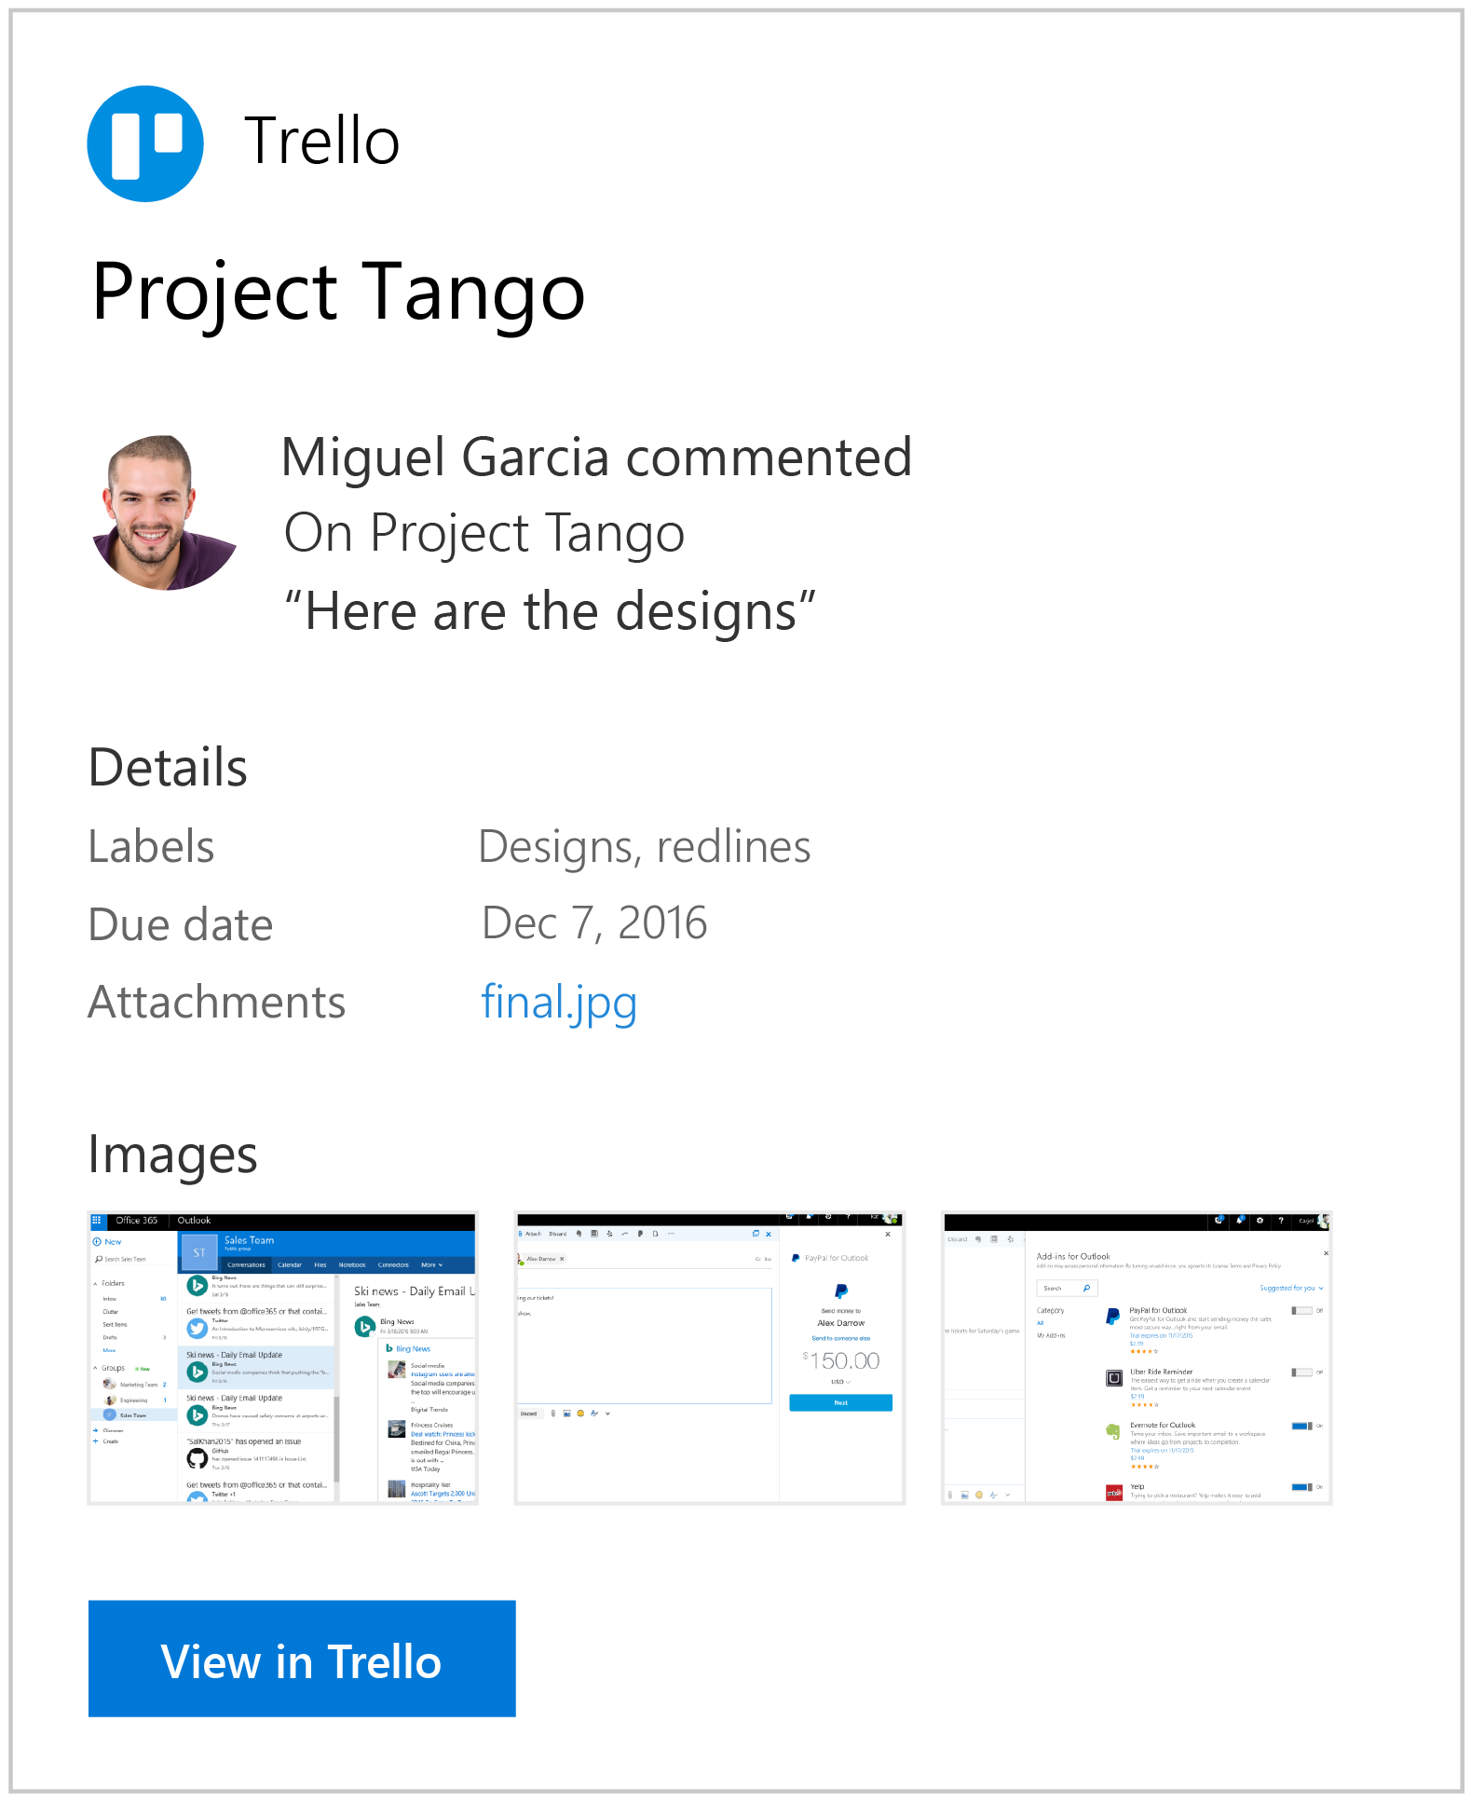
Connector Cards
{
"summary": "Miguel Garcia commented on Trello",
"title": "Project Tango",
"sections": [ {
"activityTitle": "Miguel Garcia commented",
"activitySubtitle": "On Project Tango",
"activityText": "\"Here are the designs \"",
"activityImage": "http://aka.ms/pic01.jpg",
}, {
"title": "Details",
"facts": [
{ "name": "Labels", "value": "Designs, redlines” },
{ "name": "Due date", "value": "Dec 7, 2016" },
{ "name": "Attachments", "value": "[final.jpg](http://aka.ms/pic04.jpg)" }
] }, {
"title": "Images",
"images": [
{ "image":"http://aka.ms/pic05.jpg" },
{ "image":"http://aka.ms/pic06.jpg" },
{ "image":"http://aka.ms/pic07.jpg" }
] } ],
"potentialAction": [ {
"@context": "http://schema.org",
"@type": "ViewAction",
"name": "View in Trello",
"target": [ "https://trello.com/c/1101/" ] } ] }

Slide 17
Developing Connectors
Demo
Notes:
Demonstrate the connectors publishing portal https://outlook.office.com/connectors/publish
Run the Bills List application and show the creation of a subscription (possibly with a breakpoint in the callback)
Create a new post in Bills List and show the result in Office 365

Slide 18
3
Advanced Scenarios

Slide 19
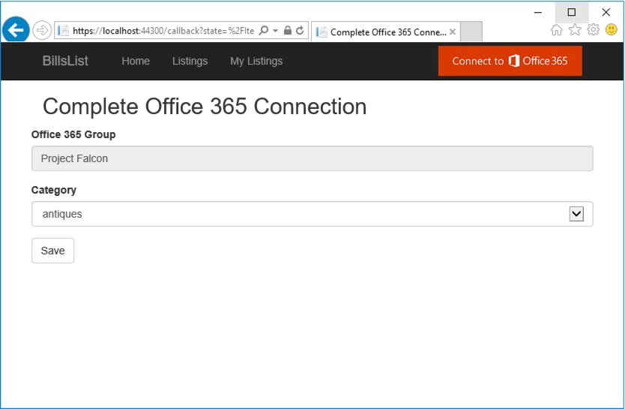
Filtering/Aggregation
Filtering/Aggregation
First party Connectors often have custom forms for configuring filtering/aggregation
Third party Connectors can achieve add filtering/aggregation on the callback (reply URL)

Slide 20
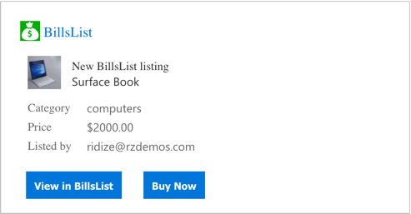
Actions
Actions
v1 Connectors support navigable action links (ViewAction)
Action target needs all the details needed to perform the action and treat as a popup

Slide 21
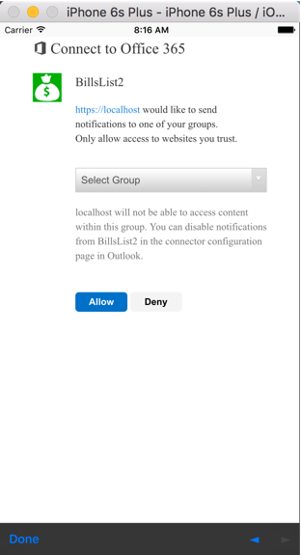
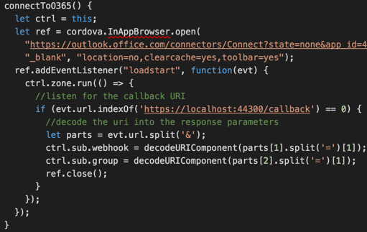
Mobile Applications
Mobile Applications
Use browser control/plugin and URL changed event to watch for the callback
Callback URI still needs to be real to work from the Connector catalog

Slide 22
Advanced Scenarios
3 App registration tool
Demo
Notes:
Demo filtering, actions, and mobile

Slide 23
Summary
Introduction
Office 365 Connectors Overview
Developing Connectors
Advanced Scenarios

Slide 24
Developer Program launch
1 YEAR FREE
Email Newsletters
Free Developer Subscription
Free Training
Free Tools
Webinars
http://dev.office.com/devprogram

Slide 25
Engage

